Slide 1
Android Programming Mobile Development
Dr Ian Drumm

Slide 2
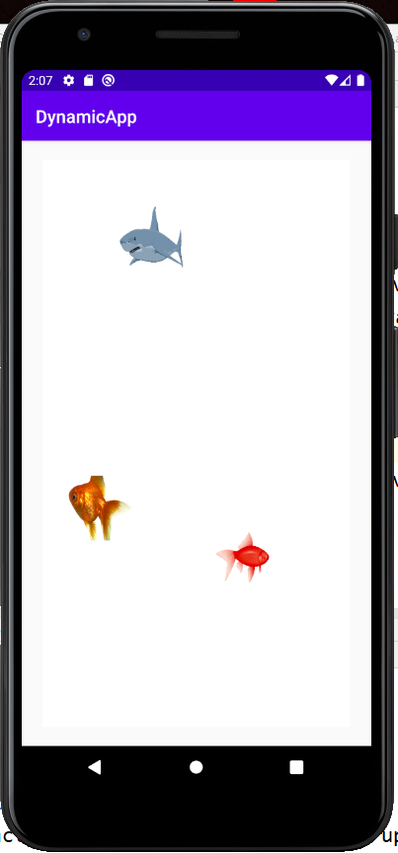
Graphics and Threads
Aims:
Animation
Learning Outcomes:
Threads
SurfaceView

Slide 3

What is a Thread?
A process of execution or task
Android can manage several independent tasks (threads) simultaneously (multithreading)
Time slicing (each thread grabs milliseconds)

Slide 4
The Main Thread
By default all components of the same application run in the same process and thread (called the "main" thread)
UI events are queued up and de-queued
If app does other things UI can be unresponsive

Slide 5
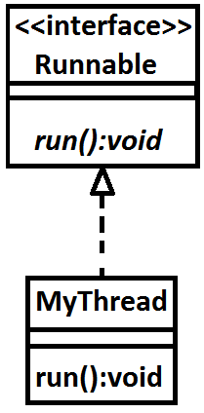
Runnable interface
Typically a threaded class realises a Runnable interface
And so implements a concrete run() method
The run() method contains code to be run in a separate process

Slide 6
Defining you thread
public class MyThread implements Runnable {
@Override
public void run() {
while(isRunning)
{
// Code here runs in separate process
}
}
}

Slide 7
The Thread class
Declare and Instantiate a Thread object
And start the thread
Thread myThread;
myThread = new Thread(new MyThread());
myThread.start();

Slide 8
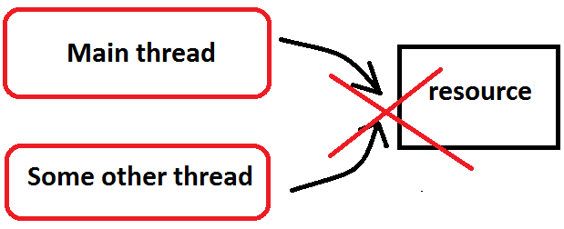
The Main Thread
You can create other threads to do work
Not necessarily thread-safe, i.e. other tasks trying to access it would compete for resources and cause conflicts

Slide 9
Sub classing a View
One way to get a reference to a Canvas
But not thread safe
public class MyView extends View {
float x,y;
// getters and setters for x, y here
@Override
protected void onDraw(Canvas canvas) {
super.onDraw(canvas);
canvas.drawText("Hello", x, y, paint);
}
}

Slide 10
SurfaceView
Sub classing a View class for drawing means all drawing happens in the main thread
A SurfaceView can be drawn on by background threads, ... Views can't.
You can sub class SurfaceView class for graphics in separate thread
And use instance of SurfaceHolder to lock canvas to avoid conflicts

Slide 11
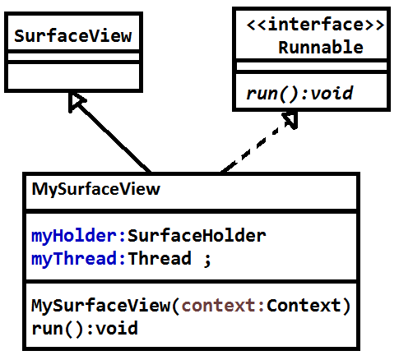
SurfaceView

Slide 12
public class MySurfaceView extends SurfaceView implements Runnable {
SurfaceHolder myHolder;
Thread myThread;
boolean isRunning=true;
Paint paint;
public MySurfaceView(Context context) {
super(context);
paint = new Paint();
paint.setColor(Color.YELLOW);
paint.setTextSize(100);
myHolder = getHolder();
myThread = new Thread(this);
myThread.start();
}
@Override
public void run() {
while(isRunning)
{
if(!myHolder.getSurface().isValid())
continue;
Canvas canvas = myHolder.lockCanvas();
canvas.drawText("Hello", 100, 100, paint);
myHolder.unlockCanvasAndPost(canvas);
}
}
}

Slide 13
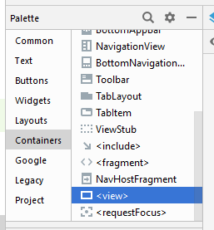
Adding your View object to your UI design
Can add a <view> a fragment’s xml
You hence can associate this with your custom MySurfaceView class

Slide 14
Drawing images
Drawable style according the app theme
Drawable without all theme attributes
Drawable d = ContextCompat.getDrawable(
getActivity(), R.drawable.name
);
Drawable d = ResourcesCompat.getDrawable(
getResources(), R.drawable.name, null
);

Slide 15
Drawing images to surface view
Image is reference to drawable
d.setBounds(X,Y,X+W,Y+H);
d.draw(canvas);

